Slide 1
Structural calculation of pipe rehabilitations according to the DWA-A 143-2
Dipl.-Ing. (Univ. Belgrade) Vladimir Lacmanovic

Slide 2
Agenda
Basics for the structural calculation of buried pipes A 127
Basics for the structural calculation of Liners A 143-2
Verifications and proofs of Liners according to A 143-2
Software IngSoft EasyPipe
Examples (Live)
FEM Analysis

Slide 3
ATV-DVWK-A 127 standard - abstract
Structural calculation of buried pipes

Slide 4
Pipe-Soil-System
ATV-DVWK-A 127 standard
Soil
Air

Slide 5
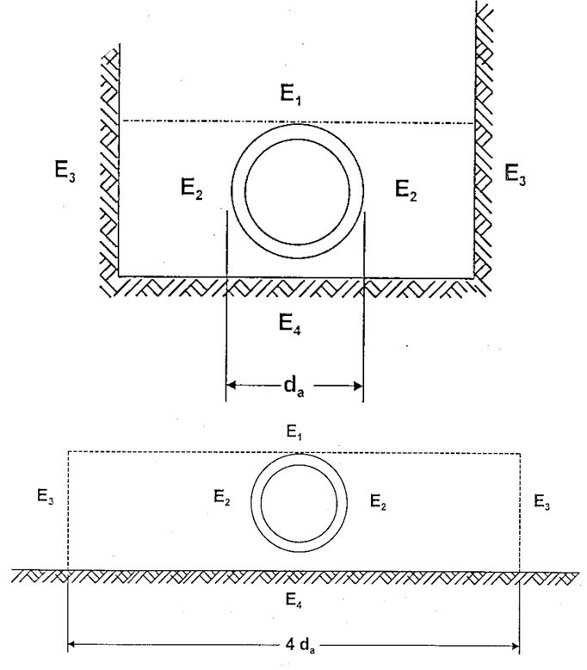
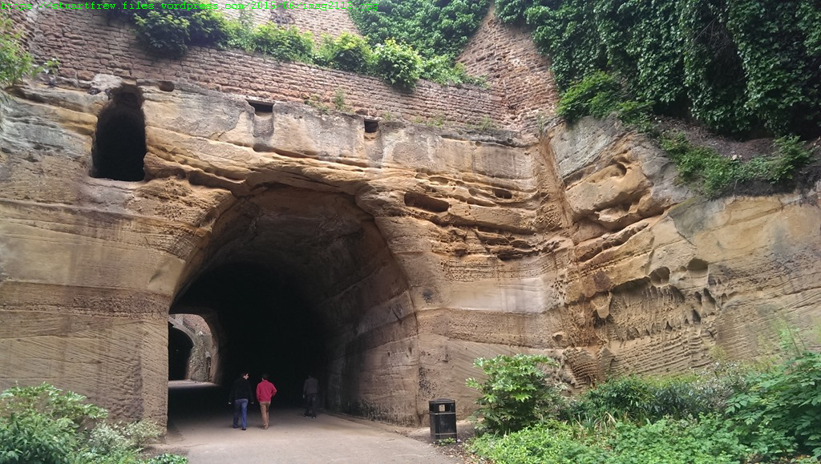
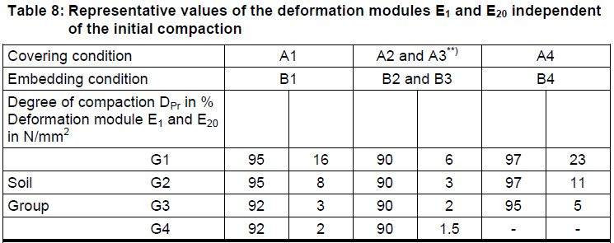
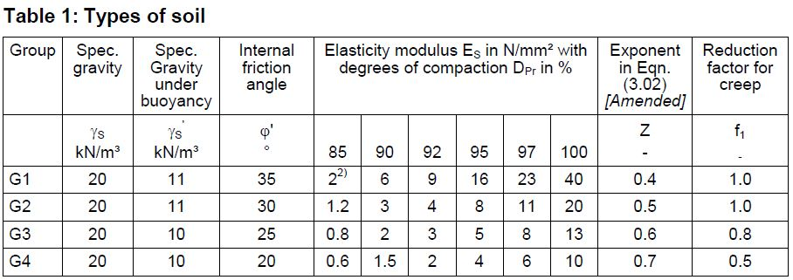
Soil
ATV-DVWK-A 127 standard
Great importance for structural calculation
For a solid rock, the pipe only prevents leakage (solid rock is self-supported)
Poor soil in bedding zone combined with great coverage or heavy traffic breaks the strongest pipe
Soil types according to ATV-DVWK-A 127
Soil zones around pipe and Young’s modulus accordingly
Assumption of consolidated soil in DWA-A143-2 E₁ = E₂ = E₃ = E₄

Slide 6
Rigid Pipe-Soil-System
ATV-DVWK-A 127 standard
System stiffness V_{RB}
V_{RB} = S_{R} / S_{Bh}
Rigid pipe
V_{RB} > 1 → rigid Pipe-Soil-System
Concentration factor λ_{R}
Depends on bedding, stiffness ratio etc.
Concrete, reinforced concrete and stoneware pipes always result in a rigid Pipe-Soil-System
Rigidity of the Pipe-Soil-System of thermoplastic, duroplastic and even metal pipes depend on the system stiffness
Notes:
Animation
Mineralwolle auf Tafel einzeichnen
Einfeldträger mit Feder auf Tafel zeichnen: Höhere Verdichtung im Bereich E1 (Überschüttung) ist ungünstig(er) für das Rohr

Slide 7
Flexible Pipe-Soil-System
ATV-DVWK-A 127 standard
System stiffness V_{RB}
V_{RB} = S_{R} / S_{Bh}
Flexible pipe
V_{RB} ≤ 1 → flexible Pipe-Soil-System
Concentration factor λ_{R}
Depends on bedding, stiffness ratio etc.
The pipe deforms enough to transmit the greater part of the loads on the nearby soil but only in the usability tolerance limits
Notes:
Animation
Mineralwolle auf Tafel einzeichnen
Einfeldträger mit Feder auf Tafel zeichnen: Höhere Verdichtung im Bereich E1 (Überschüttung) ist ungünstig(er) für das Rohr

Slide 8
Theory
Basics for the structural calculation of Liners
DWA-A 143-2

Slide 9
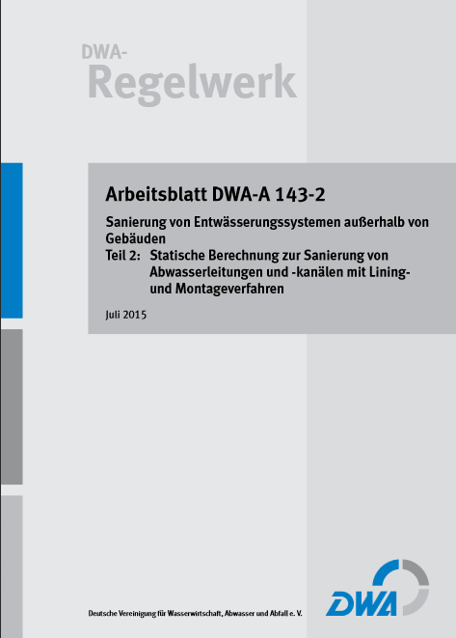
DWA-A 143-2
Theory DWA-A 143-2
A 143-2
Semi-probabilistic concept
Three (+1) host pipe conditions
Traffic loads: LM1, LM71 etc.
Interaction proof
Shear proof
Dynamic proof

Slide 10
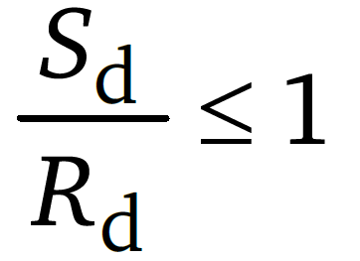
General design form
Theory DWA-A 143-2
Stresses
S_{D} Design value of the influences S_{D} = Σ (Influences x Partial safety factors γ_{F})
R_{D} Design value of the material resistance R_{D} = Material strength / Partial safety factor for the specific material γ_{M}
Deformations
are limited to 10 % total (elastic + imperfections)
Elastic deformations are limited to
δv,el ≤ 3 % for the water pressure due to groundwater
δv,el ≤ 6 % for earth and traffic loads
δv,el ≤ 2 % or 10 mm in German railway (DB) inner pressure area

Slide 11
Semi-probabilistic Concept in A143-2
Theory DWA-A 143-2
… semi-probabilistic concept in the DWA-A 143-2 leaning on Eurocodes with:
Partial safety coefficients γ_{F} for influences
Permanent loads (Dead load, Earth loads, Surface loads, etc.) γ_{F} = 1.35
Variable loads (Traffic loads except road traffic load, Groundwater) γ_{F} = 1.50
Road traffic loads γ_{F} = 1.35
Short term floodwater γ_{F} = 1.10
Internal pressure (including pressure surge) γ_{F} = 1.50
Inspection pressure γ_{F} = 1.20
Temperature change γ_{F} = 1.10
Imposed deformations γ_{F} = 1.10

Slide 12
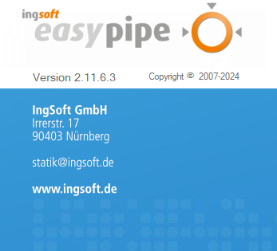
Semi-probabilistic Concept in A143-2
Theory DWA-A 143-2
Semi-probabilistic concept in the DWA-A 143-2 leaning on Eurocodes with:
Partial safety coefficients γ_{M} for material resistance
Plastic liners, hardened on site γ_{M} = 1.35
Pre-fabricated plastic liners (Extrusion or similar) γ_{M} = 1.25
Cement liner γ_{M} = 1.50
Stainless steel γ_{M} = 1.15
Resistance with a favorable effect (e.g. Imposed liner deformations at HPC III) γ_{M} = 1.00
Concrete and vitrified clay host pipes for the proof of pressure zones (eq. 102) γ_{M} = 1.50
Coefficients for combinations ψ
Temperature change combined with groundwater ψ = 0.7
Actual groundwater combined with earth and traffic loads ψ = 0.9
Replacement load for groundwater combined with earth and traffic loads ψ = 0.7

Slide 13
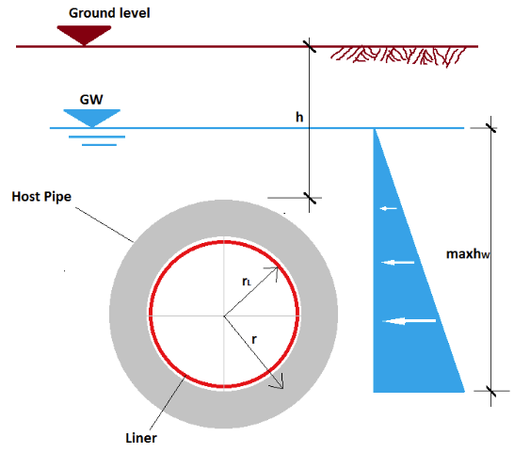
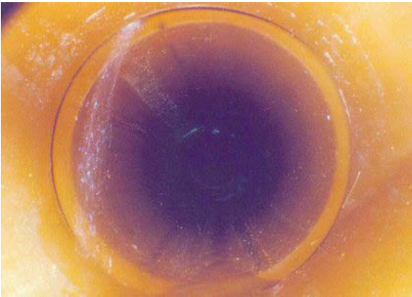
Host Pipe Condition I
Theory DWA-A 143-2
Host pipe alone is capable of bearing loads
Leaks in connections
no cracks (only capillary cracks)
Imperfections
Local imperfection
Annular gap
Influence
Outer pressure due to groundwater
Required proofs
Stresses and deformations
Buckling (Stability)

Slide 14
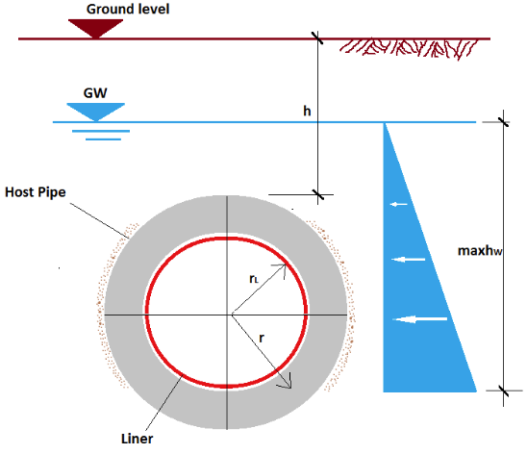
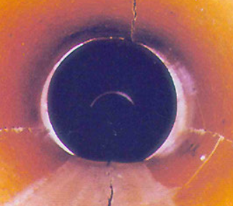
Host Pipe Condition II
Theory DWA-A 143-2
Host pipe-soil system is capable of bearing loads
Longitudinal cracks, minor pipe deformation δ_{V} < 6 %
Functionality of the lateral bedding proven through soil boring
Imperfections
Local imperfection
Annular gap
Ovalization
Influence
Outer pressure due to groundwater
Required proofs
Stresses and deformations Buckling (Stability)

Slide 15
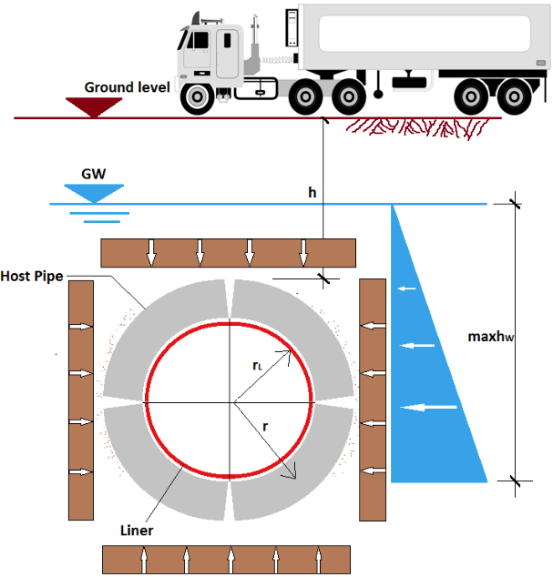
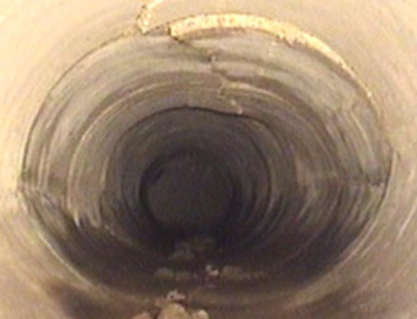
Host Pipe Condition III
Theory DWA-A 143-2
Host pipe-soil system no longer capable of bearing loads in the long-run
longitudinal cracks, significant pipe deformation δ_{V} ≥ 6 %
In addition to HPC II liner takes up earth and traffic loads
Imperfections
Local imperfection
Annular gap
Ovalization
Influence
Outer pressure due to groundwater
Earth and traffic loads
Required proofs
Stresses (in host pipe as well), deformations, Buckling (Stability)
Interaction (superposition or combined on the same system)

Slide 16
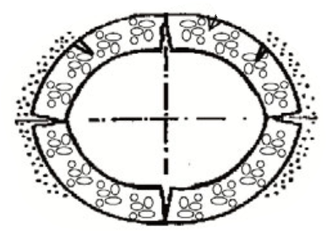
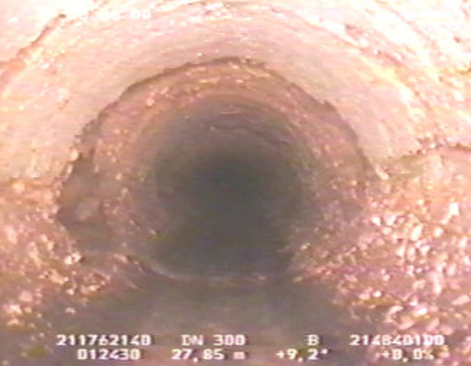
Host Pipe Condition IIIa (informative only )
Theory DWA-A 143-2
As HPC III however
the load transmission in the host pipe pressure zones is not possible due to insufficient strength of host pipe material
Pressure transmission in the springlines not possible
host pipe is cracked in fragments not in four joints
HPC IIIa has an informative character only and finds place in appendix K of the DWA-A 143 part 2
Liner is calculated as buried pipe (elastically bedded ring) according to the ATV-DVWK-A 127
Host pipe is regarded as “gravel”

Slide 17
Host pipe condition II or III?
Theory DWA-A 143-2
 | Determination point | HPC II | HPC III
1 | Ovalization ω_{GR,V} | ≤ 6 % | > 6 %
2 | Cover depth h | High | Low¹
3 | Traffic load influence | Low | High
4 | Load increase in time (foundations, surface load) | No | Yes
5 | Plaster marks are opening | No | Yes
6 | Proof q_{v,d} / krit q_{v,d} (according to the appendix F) | ≤ 1 | > 1
7 | Cavity formation in soil due to infiltration | No | Yes
8 | HP-Soil-System with Liner under h_{W} displaceable | Yes | No
1) Note: cover depth h < 1m and h < d_{a} for road traffic loads h < 1.5 m under railway loads

Slide 18
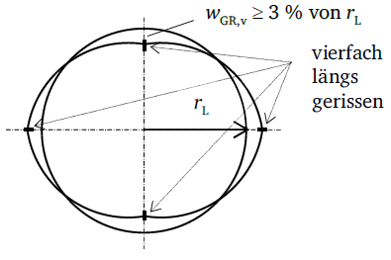
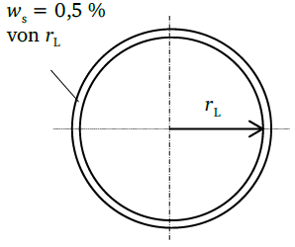
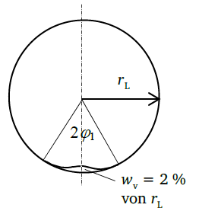
Imperfections circular shape
Theory DWA-A 143-2
Local imperfection
Consider deformations in the host pipe during the installation of the liner as well as the abbreviation from the planned trace
Consider structural imperfections (local decrease of stiffness and/or wall-thickness)
Is required in the calculation to trigger the decisive buckling case
Ovalization
Is the form that host pipe takes after its cracked in crown, invert and springlines
Annular gap
Occurs through shrinking of the resin in the liner or shrinking of the filling material

Slide 19
Imperfections
Theory DWA-A 143-2
Egg-shaped profile
Four joint deformation inwards
HPC II and III
Local imperfection results as
ω_{L} = ω_{L} + ω_{GRV}/10 = (0,5% + 3,0%/10) x r_{K} = 0.8% r_{K}
Imperfections are defined more precisely in the DWA-A 143-2 dependent on:
Installation method
Load case and HPC I – II – III
Profile geometry

Slide 20
Minimal required imperfections
Theory DWA-A 143-2
Circular liner geometry
Egg-shaped liner geometry
Method | Hose | Back-formed | Single pipe | Wounded without gap | Wounded | Pinched
Local imperfection | ≥ 2% | ≥ 2% | ≥ 1% | ≥ 1,5% | ≥ 1% | ≥ 2%
Ovalization (II,III) | ≥ 3% | ≥ 3% | 0% | ≥ 3% | 0% | ≥ 3%
Gap | ≥ 0,5% | ≥ 2% | ≥ 1-2 mm | ≥ 2 | Material dependent | ≥ 0.12%
 | Non masoned host pipe | Masoned host pipe
Local imperfection | ≥ 0,5% (r_{K}) +ω_{grv}/10 | ≥ 1% (r_{K}) + ω_{grv}/10
Ovalization (II,III) | ≥ 3% (crown radius)
Gap | ≥ 0,4%

Slide 21
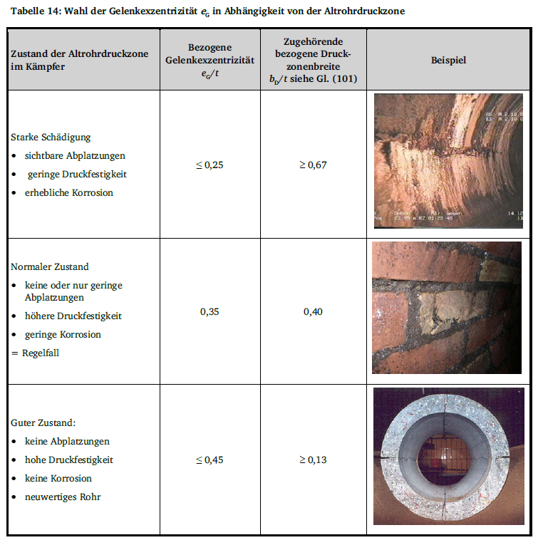
Eccentricity
Theory DWA-A 143-2
HPC III
Distance of the rotation point (crown joint) to the mid-axis (the better the host pipe, the higher the value)
Input in % of the host pipe thickness
Normal HP state e_{G}= 0,35

Slide 22
Loads
Theory DWA-A 143-2
Load | HPC I | HPC II | HPC III
Self-load | X | X | X
Temperature difference | X | X | X
Water pressure due to groundwater | X | X | X
Inner pressure | X | X | X
Earth load |  |  | X
Traffic load |  |  | X

Slide 23
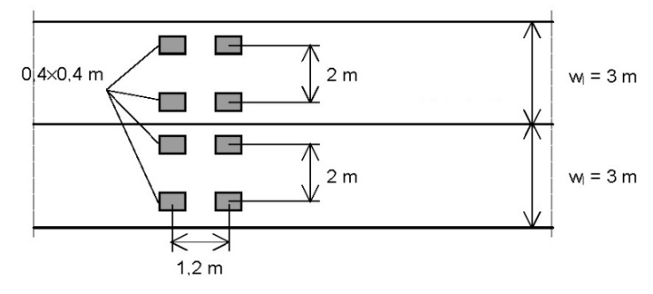
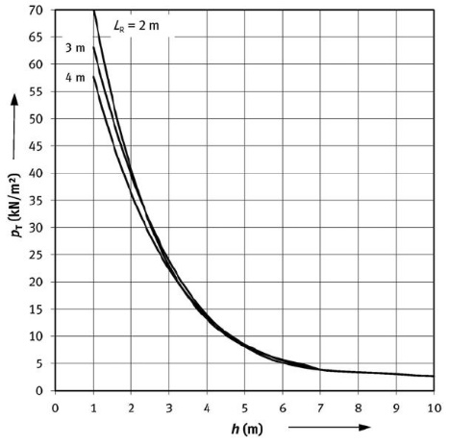
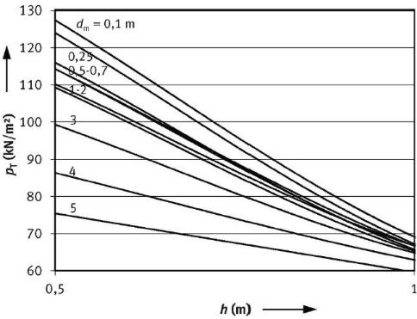
Road Traffic Loads
Theory DWA-A 143-2
Load model 1 according to DIN EN 1991-2 replaces the Street loads HGV 60, HGV 30 and Truck 12
Ground stresses due to road traffic loads in a diagram form depending on
Host pipe length
Cover depth (0.5 – 10 m)
Diameter
All diagrams and formulas for α = 0.8, it supposed to be calculated with 1.0 (German NA for EC 1-2)
Dynamic proof required for cover depths h_{E} < 1.5 m

Slide 24
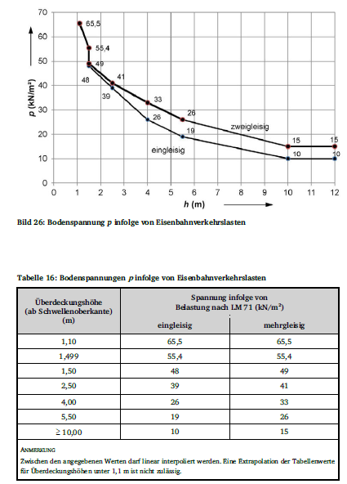
Railway Traffic Loads
Theory DWA-A 143-2
Installation with earth cover less than 1.1m allowed only with special permission
Railway load in shallow depth can be distributed according to DIN EN 1991-2
Dynamic proof required for up to 5.5m depth

Slide 25
IngSoft EasyPipe and DWA-A 143-2
Verifications and proofs

Slide 26
Verification concept in the A 143-2
Verifications and proofs
Cross-sectional forces and stresses
Stability
Inner pressure, temperature
Deformations (Service load)
Soil limit stress (Service load)
Stress in the host pipe

Slide 27
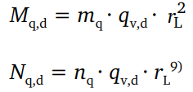
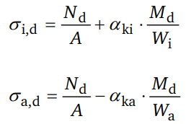
Cross-sectional forces and stresses
Verifications and proofs
Factors for cross-sectional forces
For HPC I and II (attachment D), circular and egg-shape geometry
For HPC III (attachment E), circular geometry only
Stress inner and outer fibres
α_{ki} and α_{ka} correction factors ovality
Shear stress
Shear strength required, BÜV-recommendation max. τ_{c} = 8 N/mm²
Usually not required for smooth circular and oval profiles

Slide 28
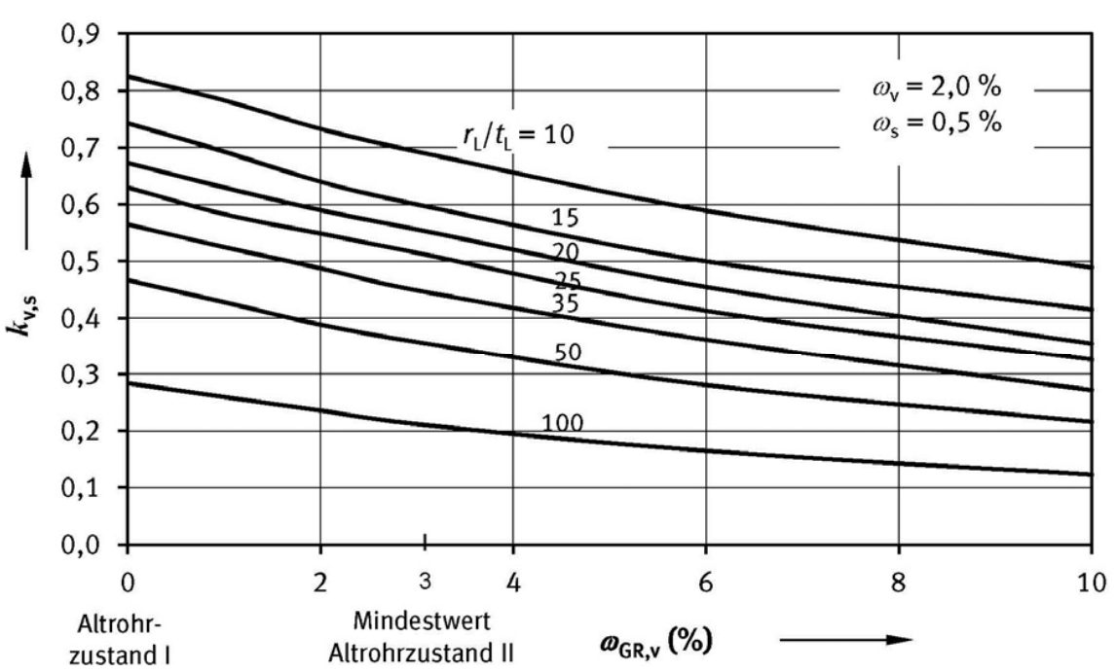
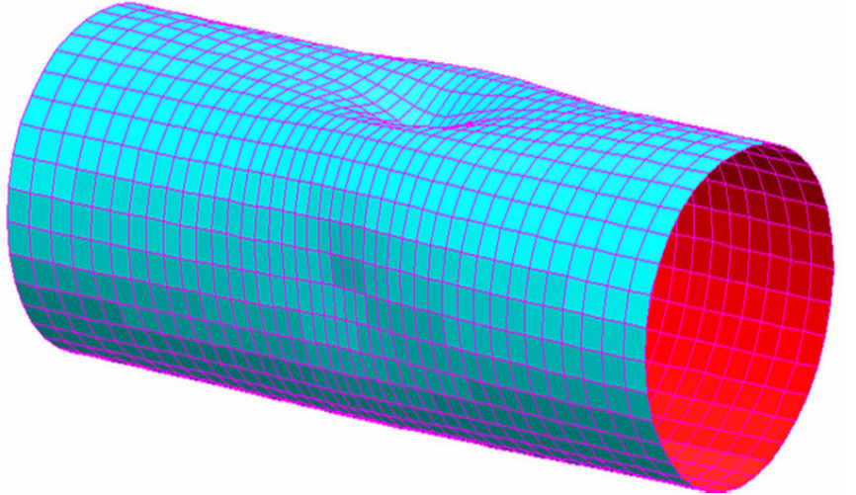
Stability
Verifications and proofs
The stability proof is a determination of the safety against buckling of rather thin-walled structures such as liner
Critical pressure
Buckling factor
Liner stiffness
Reduction factor

Slide 29
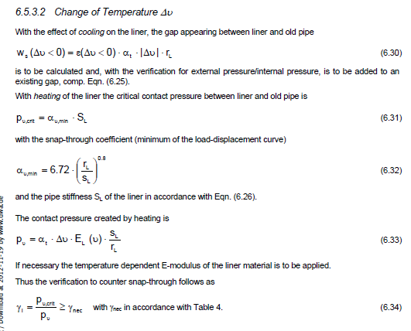
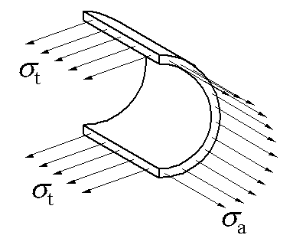
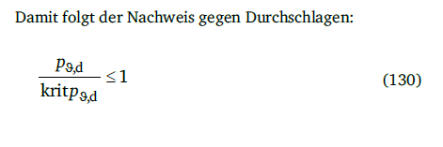
Inner pressure, temperature
Verifications and proofs
Barlow's formula
Normal force only
Temperature
Consideration of warming and cooling down
Additional gap occurs at further cooldown
Mechanical properties of plastic liner are temperature dependant

Slide 30
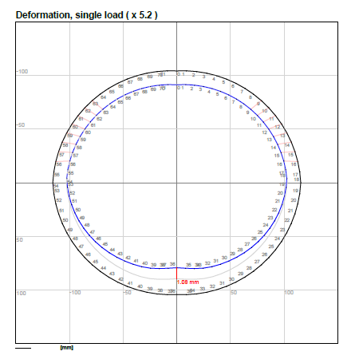
Deformations
Verifications and proofs
Serviceability verification
Partial safety factors γ_{F} = γ_{M} = 1
Total deformation δ_{v} ≤ 10%
(elastic + imperfections), guide value
Elastic deformations are limited
δ_{v,el} ≤ 3% for water pressure
δ_{v,el} ≤ 6% for earth and traffic loads
δ_{v,el} ≤ 2% or 10 mm for railway loads (DB)

Slide 31
Soil limit stress
Verifications and proofs
The sum of lateral earth pressure and bedding reaction pressure must not exceed max q_{h}
Relevant when high lateral bedding forces are required for system stabilization
for traffic loads with shallow installations e.g.
Should prevent soil fracture in the pipe springlines

Slide 32
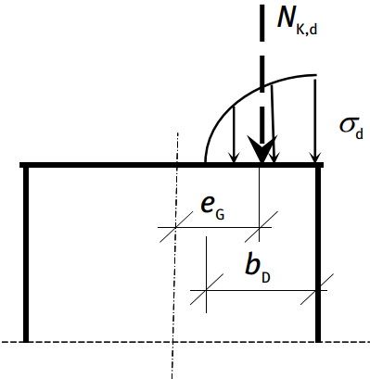
Stress in the host pipe (HPC II and III)
Verifications and proofs
Compression transmission in the springline joint must be proven in HPC III
In HPC II the proof is optional
Parabolic stress flow on b_{D}
If the proof is not fulfilled -> HPC IIIa

Slide 33
Fatigue proof
Verifications and proofs
Required for
Road traffic: LM1 earth cover < 1,5 m (calculated for LM 3 – lighter model)
Railway traffic: LM71 earth cover < 5,5 m
Airplane: BFZ
Manufacturer must determine the amplitude (time consuming tests)
LM71 with 10⁸ cycles
LM71, side tracks with 5x10⁶ cycles
BFZ, LM1: number of cycles not defined

Slide 34
IngSoft

Slide 35
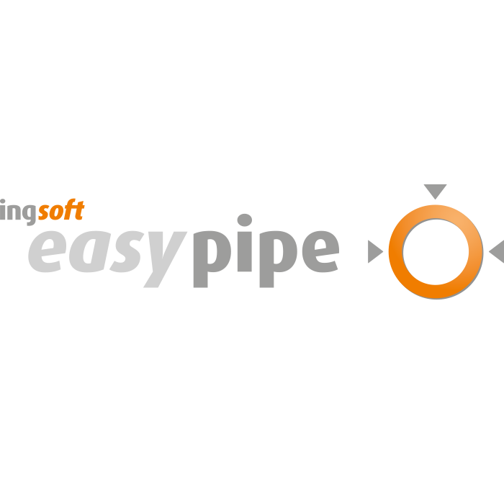
Static-Software IngSoft EasyPipe
IngSoft
A127 buried pipes in trench or dam
A161 jacking pipes
M127-2 lining according to the global safety approach, replaced by
A143-2 lining according to the semi-probabilistic safety approach
M 45 buried GRP pipes (USA)
SIA 190 buried pipes (Switzerland)
Manhole (currently EasySchacht98) DWA-M 127-4 pending
Extensions (special vehicles, profile from drawing, pipe with base, egg-shaped cross-section in HPC III in last stage of development)

Slide 36
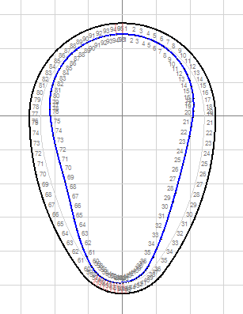
A143-2 with Extension Egg-Shaped Profiles in HPC III
IngSoft
Extension available for the modules M127-2 and A143-2
Until now, the approximation method mentioned in the set of rules made use of a substituted circle. This approach is sometimes on the unsafe side.
Egg profile in HPC III takes the actual geometry into account and incorporates it into a regular-shaped framework model

Slide 37
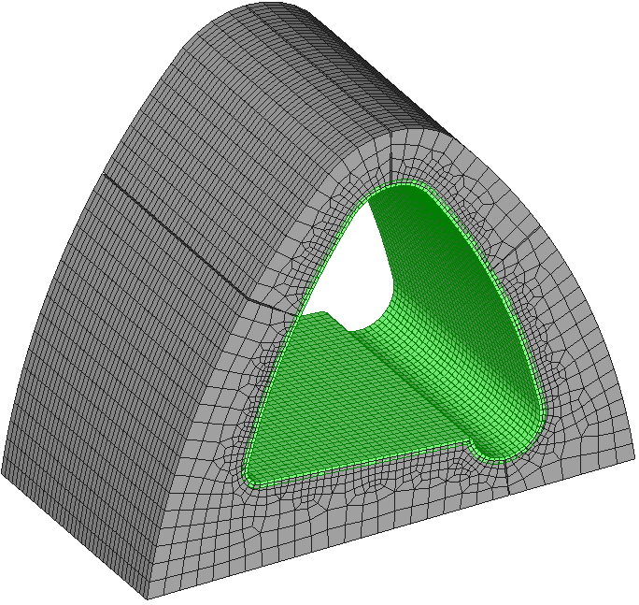
Engineer Services and finite element analysis (FEA)
IngSoft
Customers Worldwide
Manufacturers of Liners, Pipes and Manholes
Engineering bureaus, institutes and universities
Sewer and Drains Rehabilitation
Relining for arbitrary profiles in HPC I – II – III
Structural calculation for host pipe classification
Wall-thickness optimization
New Installation of Pipes, Manholes, Reservoirs
Finite Element Analyses (FEA) for special geometry

Slide 38
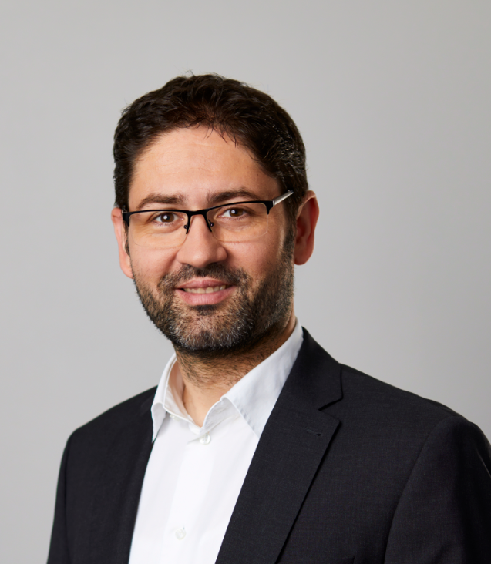
Vladimir Lacmanovic
IngSoft
2012 Dipl. Ing. (Univ. Belgrade) Structural Engineering
Since 2012 working at IngSoft
Responsible for
Static Calculations
FEM Analysis
Software IngSoft EasyPipe (Training, Support, Distribution)

Slide 39
Thank you for your attention
Contact
IngSoft GmbH Irrerstraße 17 90403 Nürnberg Germany
Tel. +49 911 430879-300
E-mail: statik@ingsoft.de
Internet: www.easypipe.ingsoft.com

