Slide 1
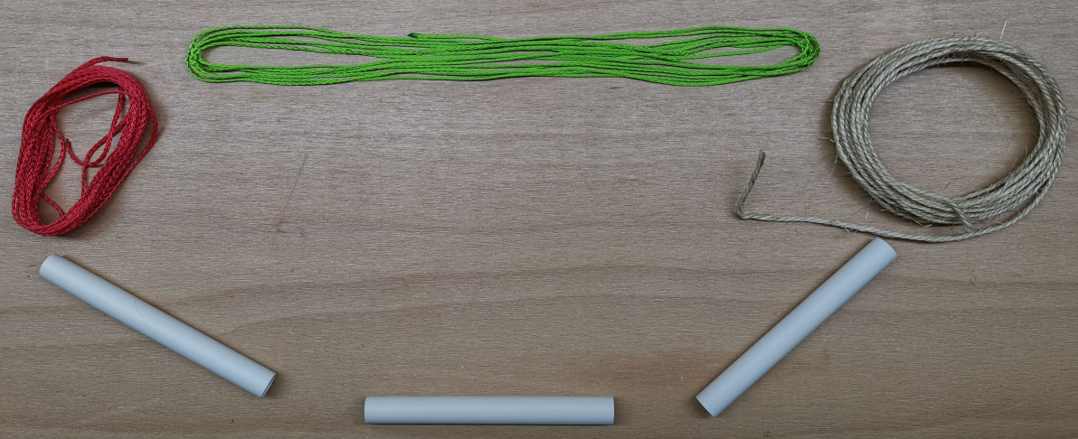
Structural aspect of HDD installations (Horizontal Directional Drilling)
HDD designs acc. DWA-A 161 / DVGW GW 312 at NO-DIG TÜRKIYE 2024
Dipl.-Ing. (FH) Frederik Müller M.Eng. IngSoft GmbH, Nürnberg, Germany

Slide 2
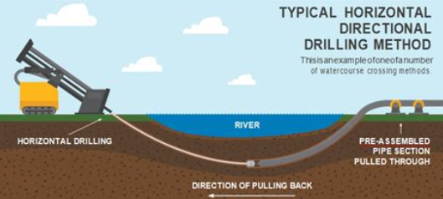
Horizontal Directional Drilling (HDD)
Introduction

Slide 3
Horizontal Directional Drilling (HDD)
Introduction

Slide 4
Agenda HDD
Set of rules: DWA-A 161 / DVGW GW 312
Terms for HDD
Live-Demo: HDD Installation
Software IngSoft EasyPipe
Calculation examples live

Slide 5
Set of rules: DWA-A 161 / DVGW GW 312
Pipe jacking in the sense of: mining, tunnelling
(not: HDD (yet))

Slide 6
Static Calculation of Jacking Pipes
Set of rules: DWA-A 161 / DVGW GW 312
Versions: Predecessor: edition 1990, Draft: September 2010, Released: March 2014
Correction sheets
May 2017
Corrections to the correction sheet in October 2017
Corrigendum September 2020 → March 2021 (due to: DWA-A127-10 material parameters)
English version May 2018 (IngSoft assisted)
Costs: 93.50- €, available at https://shop.dwa.de/en/DWA-A-161E-Static-calculation-of-Jacking-Pipes-March-2014-corrected-version-March-2021/A-161E-Hauptprodukt-14-main
Notes:
A161 = GW312

Slide 7
Overview of rules and regulations
Set of rules: DWA-A 161 / DVGW GW 312
Semi-probabilistic partial safety concept
Actions E (loads): Increase by E * γ_{F}
Resistance R: Reduce by R / γ_{M}
Verification for single pipe element
Pipe length of the individual pipe due to load approach
Bedding angle A127 <> A161
Pressure Transfer Ring (PTR): Test report!
Interaction of radial and axial direction
Iterative determination of the maximum jacking force that the individual pipe can withstand

Slide 8
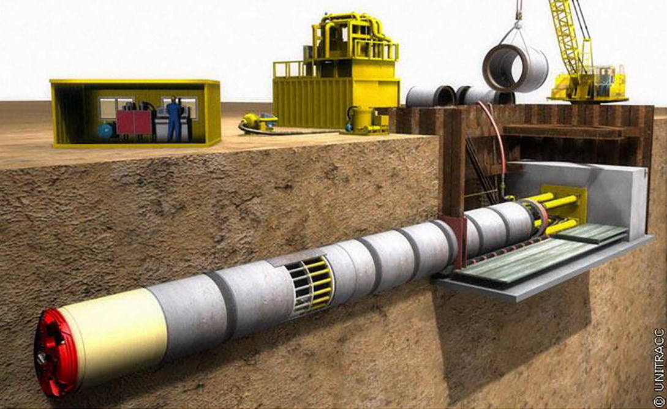
Expectations
Set of rules: DWA-A 161 / DVGW GW 312
Not covered (→ e.g. DWA-A 125)
Total length of jacking route
Surface friction between pipe and soil
Front face pressure, jacking stations
Any procedure that „pulls“ the pipe, like HDD
Covered
Single pipe element is dimensioned
Material parameters
Semi-probabilistic concept of partial safety coefficients by
Multiplication of loads by γ_{F} > 1
Division of material data by γ_{M} > 1
Interaction of radial and axial direction
Installation and operational state
https://ars.els-cdn.com/content/image/1-s2.0-S2467967418301065-gr1_lrg.jpg

Slide 9
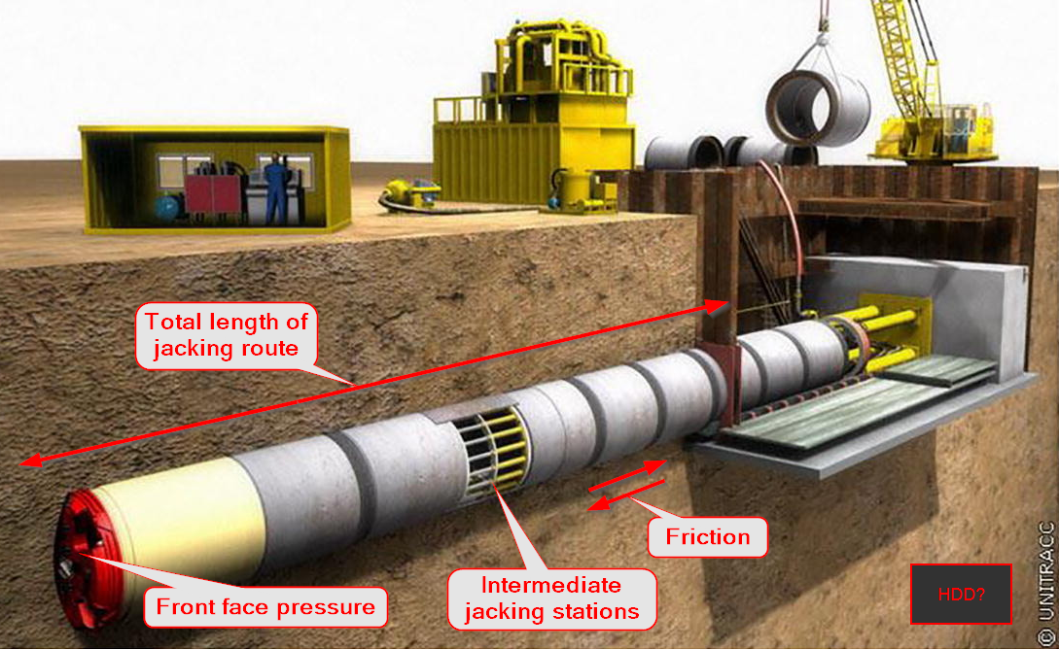

Slide 10
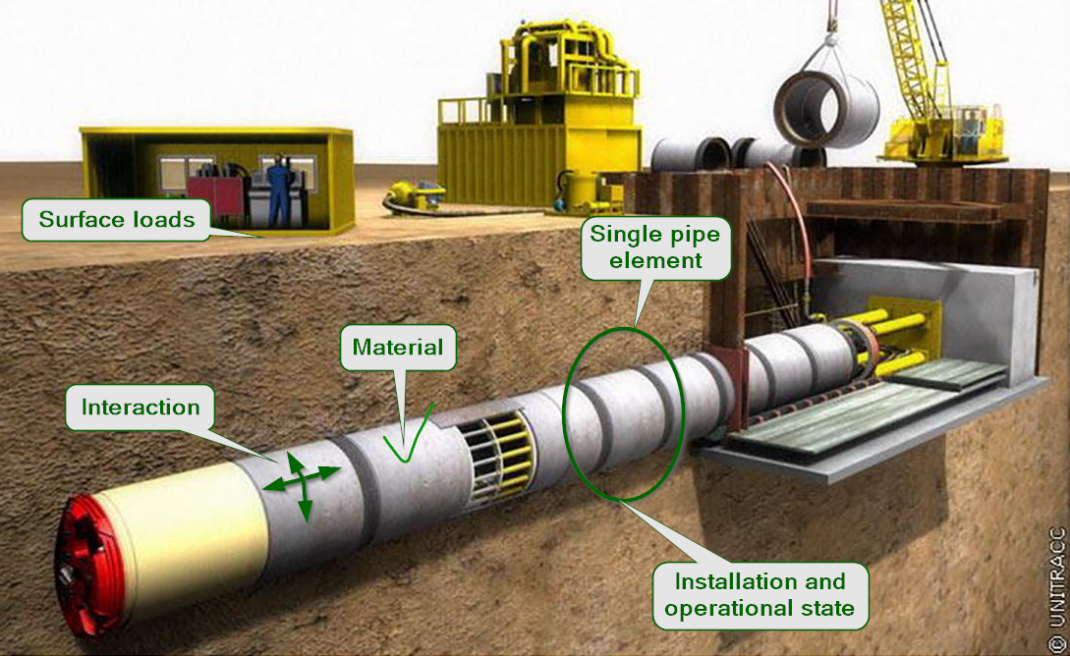

Slide 11
Loads (Actions)
Set of rules: DWA-A 161 / DVGW GW 312
Dead weight of pipe, soil
Street
Load Model 1, LM1 (instead! of SLW60/HGV60)
Cover height at least 1.0 m
Fatigue proof: 2x10^6 load cycles
Railway
Load Model 71, LM71
Impact coefficient
Cover height: 1.10 m
Fatigue proof: 1x10^8 load cycles (instead of 2x10^6)
For steel pipes: 5x10^6 possible, but 1x10^8 required if cover depth < 1.5 m, acc. EuroCode 3, EC3
Optional: ground water, inner pressure

Slide 12
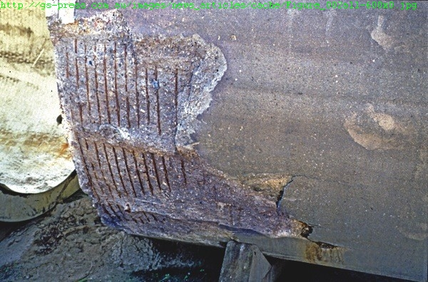
Pipe jacking
Set of rules: DWA-A 161 / DVGW GW 312
Radial and longitudinal actions
Procedures
"Classical" procedure (mining, tunnelling)
Pilot pipe
Soil displacement, burst lining
Pressure Transfer Ring (PTR)

Slide 13
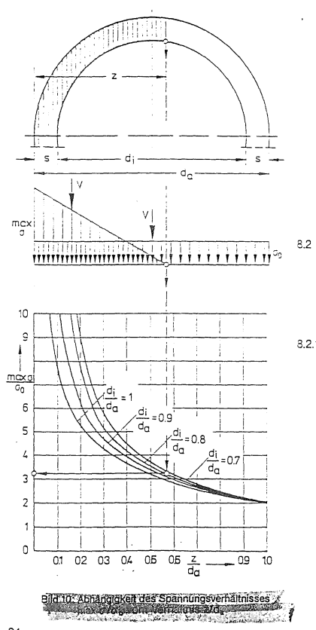
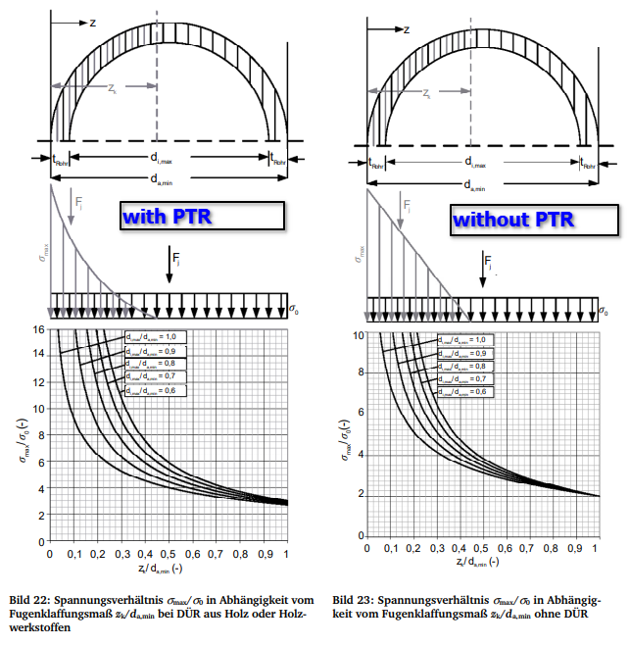
Pressure Transfer Ring (PTR)
Set of rules: DWA-A 161 / DVGW GW 312
Wooden ring
Axial stress distribution between single pipe elements
Picture 1 From ATV-A 161 (1990)
Picture 2 From DWA-A 161 (2014)
GRP in EasyPipe: no PTR

Slide 14
Special feature for jacking in mixed soils
Set of rules: DWA-A 161 / DVGW GW 312
DWA-A 161, section 8
Jacking partly in rock, partly in loose soil
Mixed soils (Fig. 9) are unfavourable for the pipe
Loose soil
Solid rock
Mixed soil

Slide 15
Special feature of jacking completely in solid rock
Set of rules: DWA-A 161 / DVGW GW 312
Reduce cover depth if necessary
Coordination with the geotechnical expert
Minimum value: two times outer diameter 2 x D_{A} (8.2.2)
ex. h_{ü}
p_{V}
red. h_{ü} > 2D_{A}
Soild rock

Slide 16
Required verifications
Set of rules: DWA-A 161 / DVGW GW 312

Slide 17
Minimum wall thickness
Set of rules: DWA-A 161 / DVGW GW 312
Why are there minimum wall thicknesses/reinforcement?
Compensation of axial/radial stress interaction
Avoidance of sudden failure
Minimum wall thicknesses
Independent of the actions ("loads")
Independent of the installation conditions
Dependent on the material (Tables 19, 20)
Reinforced concrete pipes -> DIN V 1201, 5.3.5.2: t/rm = 0.17
Depending on the nominal diameter DN
Minimum reinforcement
Section 9.3.2 ->DIN V 1201, 5.3.7
0.7% of the minimum wall thickness required

Slide 18
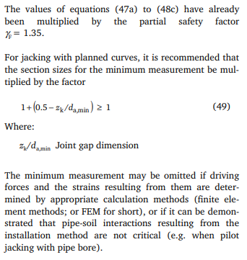
Minimum sectional forces
Set of rules: DWA-A 161 / DVGW GW 312

Slide 19
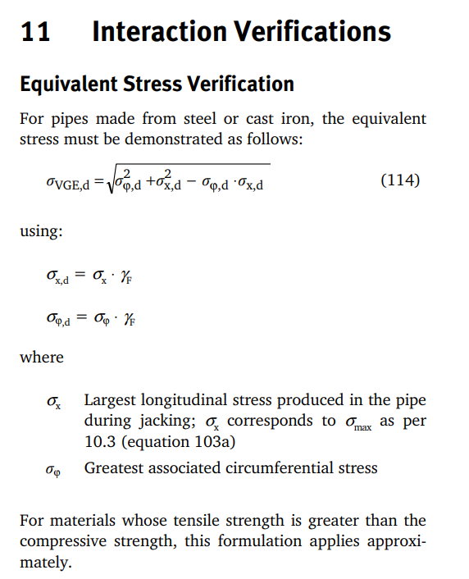
Equivalent stresses
Set of rules: DWA-A 161 / DVGW GW 312
Interaktion
Radial & axial direction overlay
Construction state
Determination of the maximum permissible jacking force

Slide 20
Approval
Set of rules: DWA-A 161 / DVGW GW 312
Earth, groundwater, inner pressure, traffic loads
Verifications for stresses/strains, deformations (circumferential)
Buckling/stability for steel, GRP, plastic pipes
Construction state
Pulling force: Tension
Curvature: Bending
Interaction of tension and bending (longitudinal)
Lubricant pressure
Operational state
Bending from installation “remains”
Service life of 50 years (and more): Long-term material characteristics for time-dependent materials, fatigue check for live loads

Slide 21
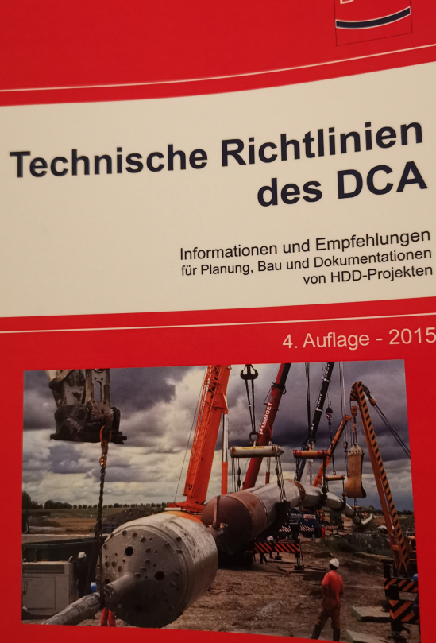
Tensile force, axial stresses: DCA Technical Guidelines
Set of rules
Longitudinal tensile force from retraction
Approach DCA: full length drawn
Coefficient of friction
Result: required tensile force
Longitudinal tensile force permissible
"Endless" pipe string (e.g. PE, steel)
Permissible stress of pipe material x ring surface
Result: permissible tensile force
Axial forces (or stresses): verification
Consider partial safety factors
Reductions, if necessary
Notes:
### ab 2. Punkt, this is where DCA ends
(Single pipes: Verification of socket e.g. with BLS, duktus)

Slide 22
Terms for Horizontal Directional Drilling (HDD)

Slide 23
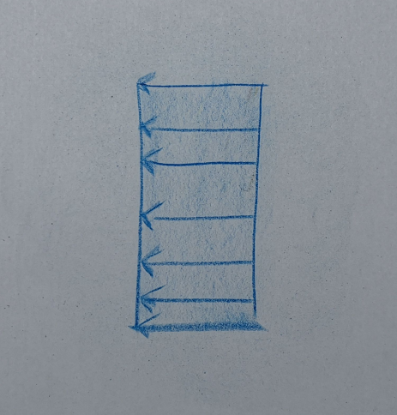
Tensile force, tensile stress
Terms
Fibres are pulled
Applies to all fibres
No relocations possible
Sign positive (+) for stresses
Notes:
### Schnur ziehen

Slide 24
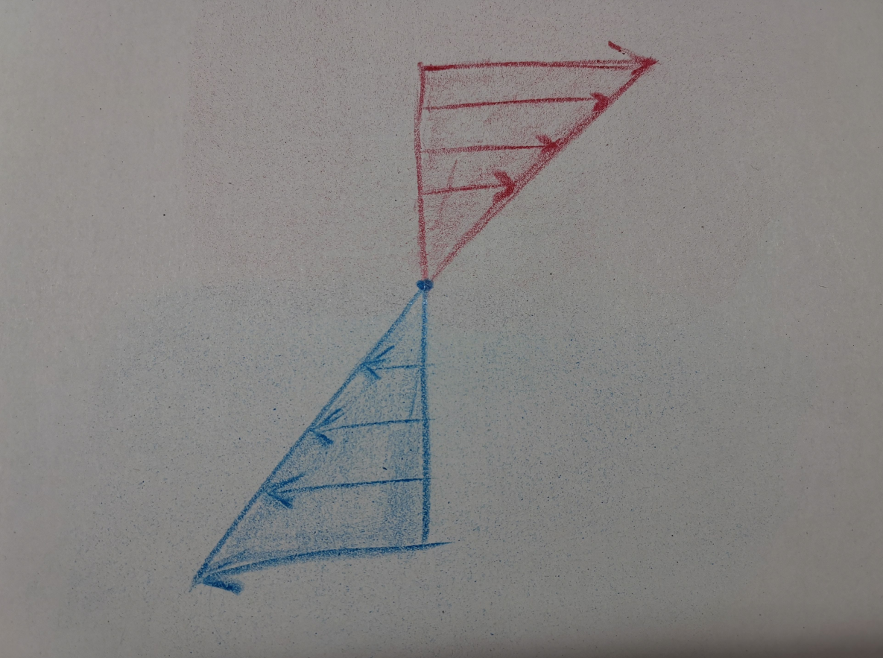
Bending moment, bending stress
Terms
Fibres are
Compressed (50%)
Pulled (50%)
Centric neutral fibre
Outermost fibres get
Maximum compression
Maximum tension
Relocations possible
Sign for stresses
Negative if compressed (-)
Positive if pulled (+)
Notes:
### Rohrstück biegen

Slide 25
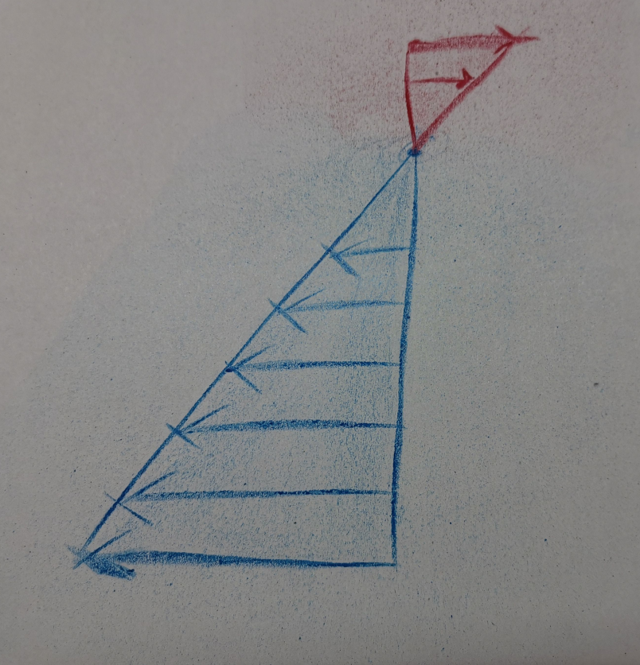
Interaction, superposition
Terms
Stress blocks superimposed
Neutral fibre shifted
Tensile + bending stresses

Slide 26
Live demonstration

Slide 27
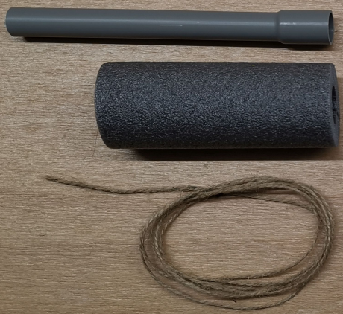
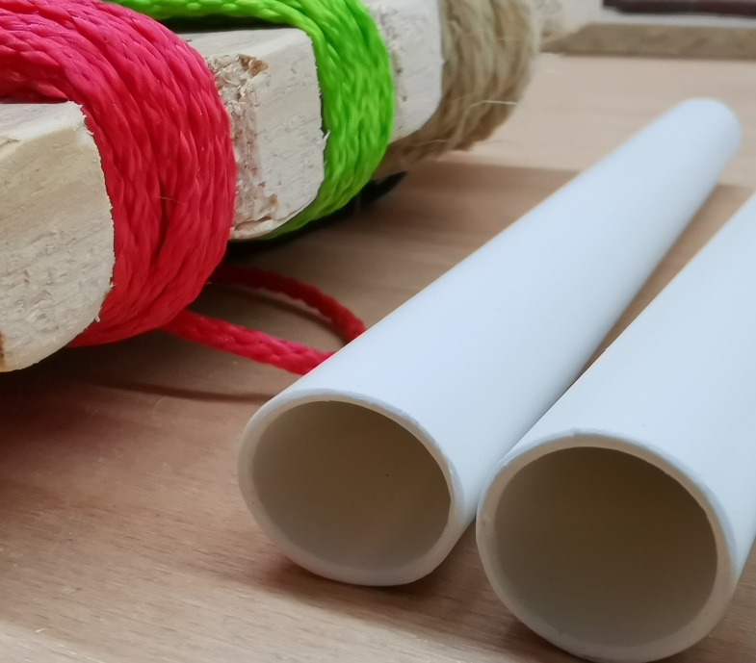
Transportation Nürnberg - Istanbul
Live demonstration

Slide 28
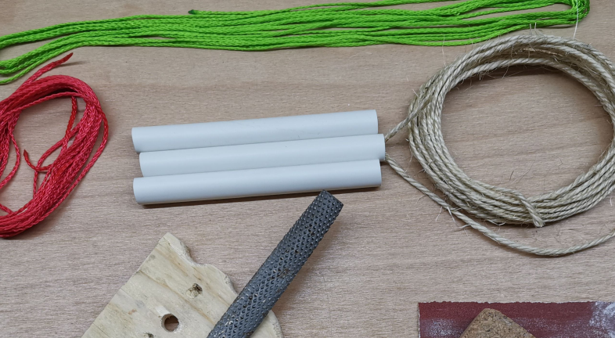
Construction state
Live demonstration
Equipment from my basement
You ☺
Notes:
### THREE volunteers required
### someone take a picture (please)

Slide 29
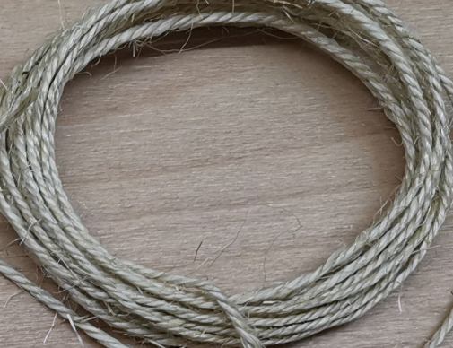
Construction state
Live demonstration
Rig ← Pull Pipe

Slide 30
HDD – Horizontal Directional Drilling
Live demonstration

Slide 31
Software IngSoft EasyPipe

Slide 32
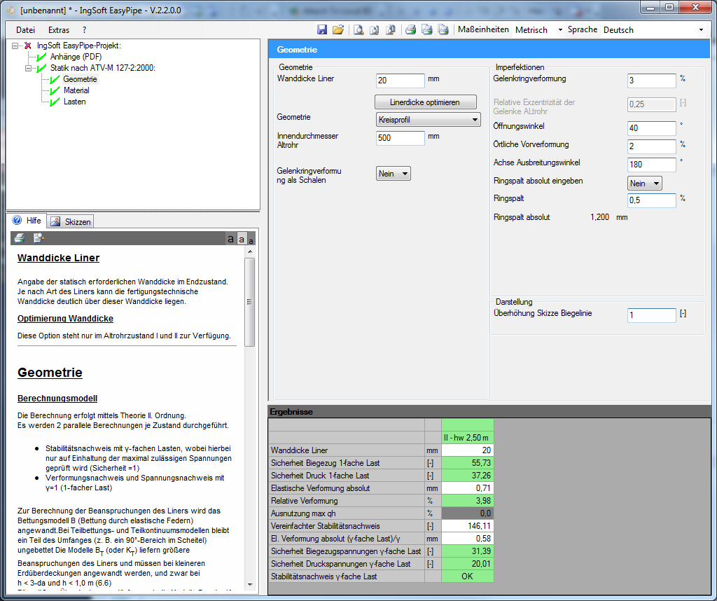
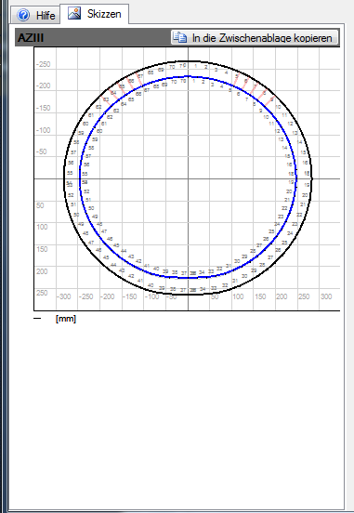
Structure of the program surface
IngSoft EasyPipe
Menu / Print / Units / Languages
Statics structure
Entry
Help / Sketch
Results

Slide 33
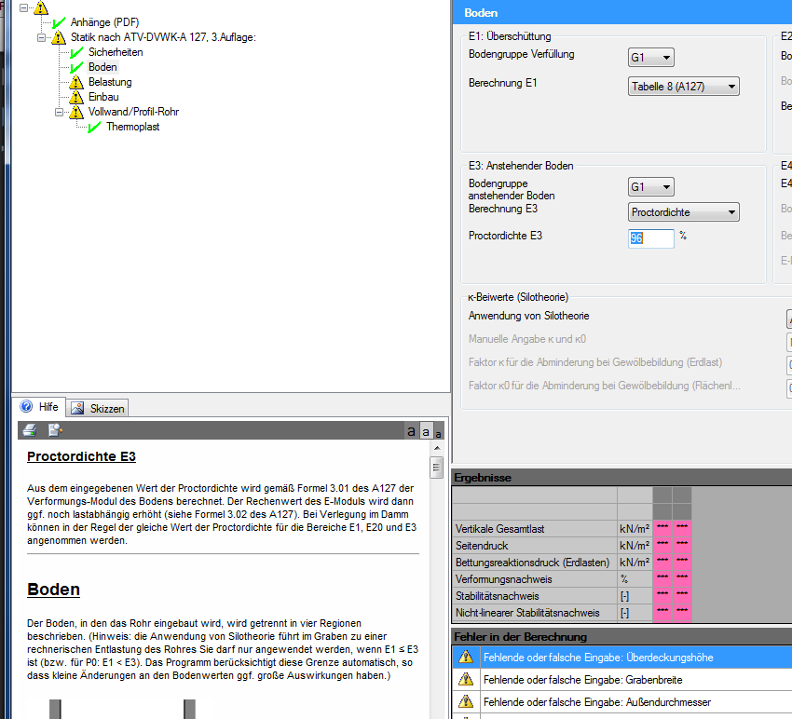
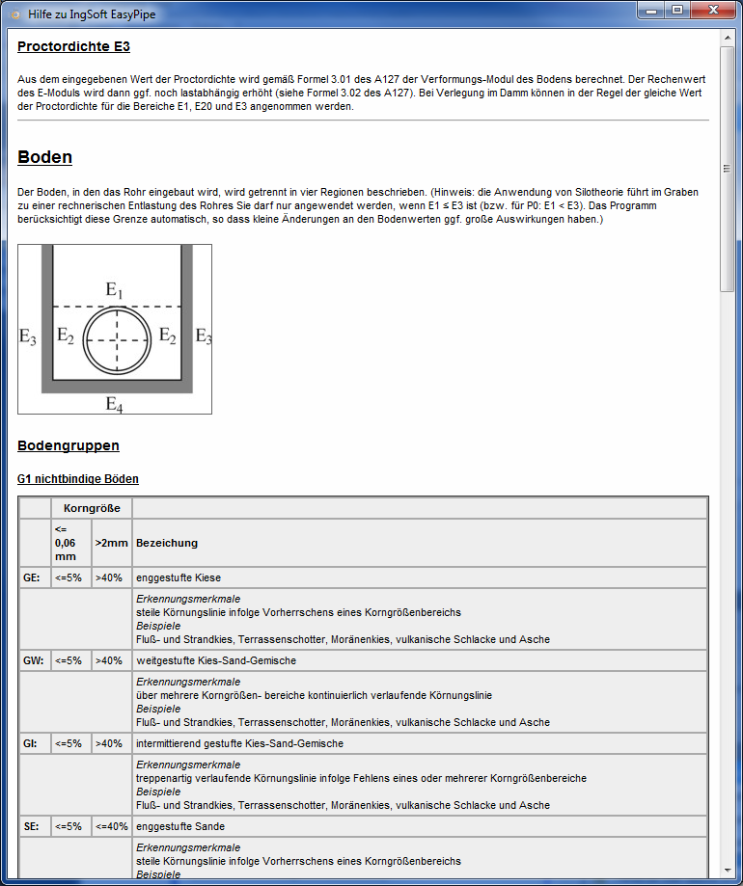
Context-sensitive help
IngSoft EasyPipe
Instead of a manual
or each chapter
For each entry
If necessary with sketches

Slide 34
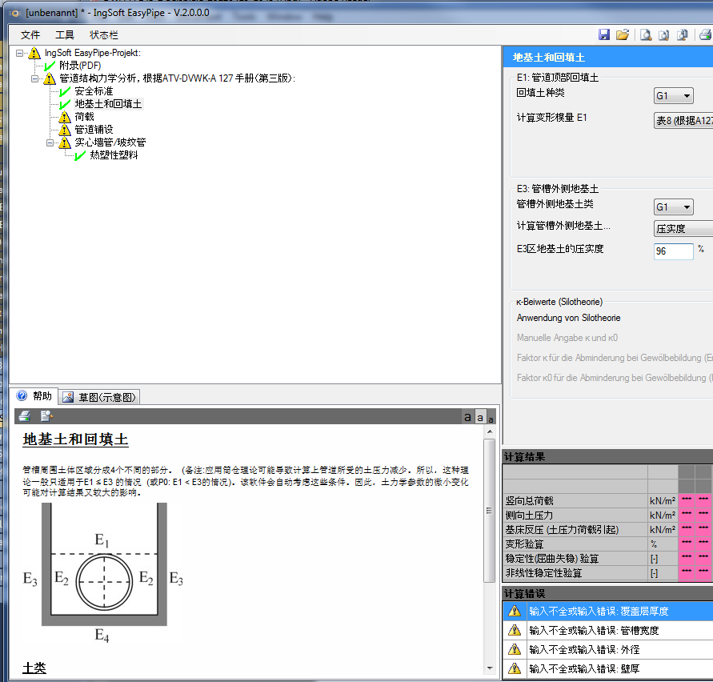
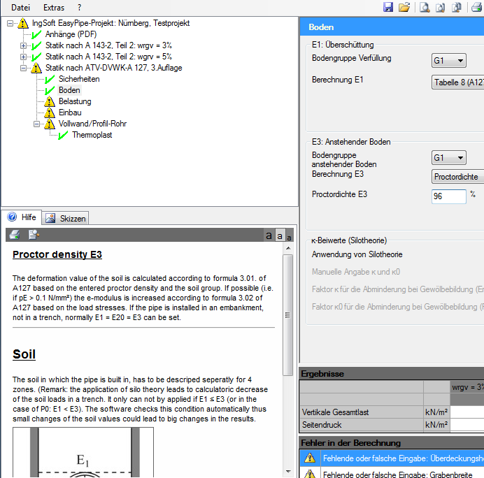
Languages and Units (Professional Edition)
IngSoft EasyPipe
Switching between languages while working
Please note: English language setting uses Point . (1.0) instead of Comma , (1,0)
Switching between metric and imperial units while working

Slide 35
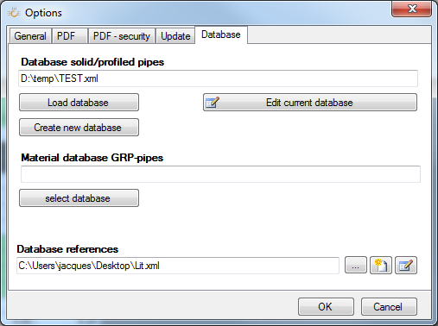
Databases (Professional Edition)
IngSoft EasyPipe
Solid and corrugated pipes incl. material
GRP pipes for A127 and A161
Reinforced concrete
Literature reference
Path to a central server
Installation folder EasyPipe will be overwritten after the update

Slide 36
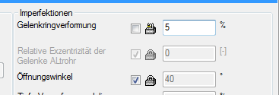
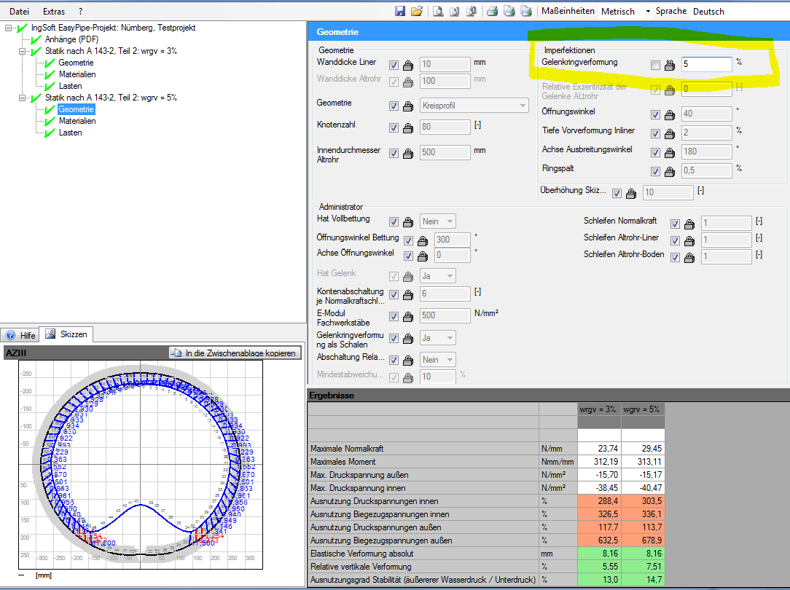
Alternatives (Professional Edition)
IngSoft EasyPipe
All entries are inherited from the source calculation
Overall changes are made in the source calculation
Individual changes are made in the alternative calculation
Build cascading projects

Slide 37
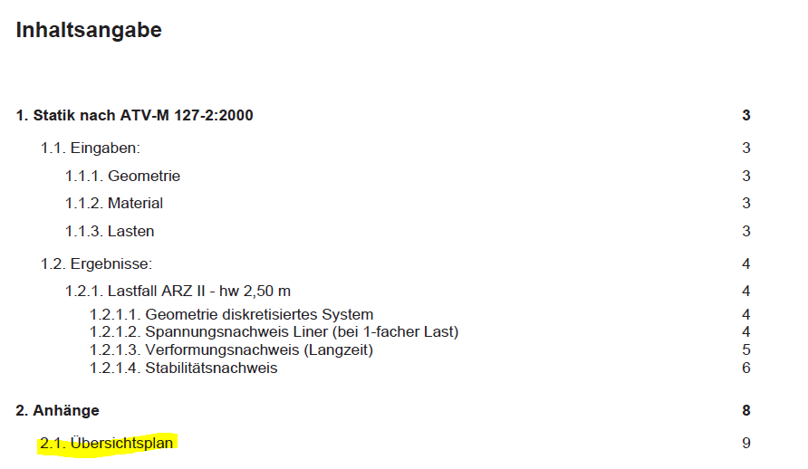
External attachments: .pdf and .jpg
IngSoft EasyPipe
As a link, missing in the IngSoftEasyPipe project file (.epn) If necessary, send attachment separatelyIs
always printed, regardless of the length of the printout
Header/footer uniform
Warning if the path has changed or been deleted

Slide 38
LIVE-DEMO
IngSoft EasyPipe

Slide 39
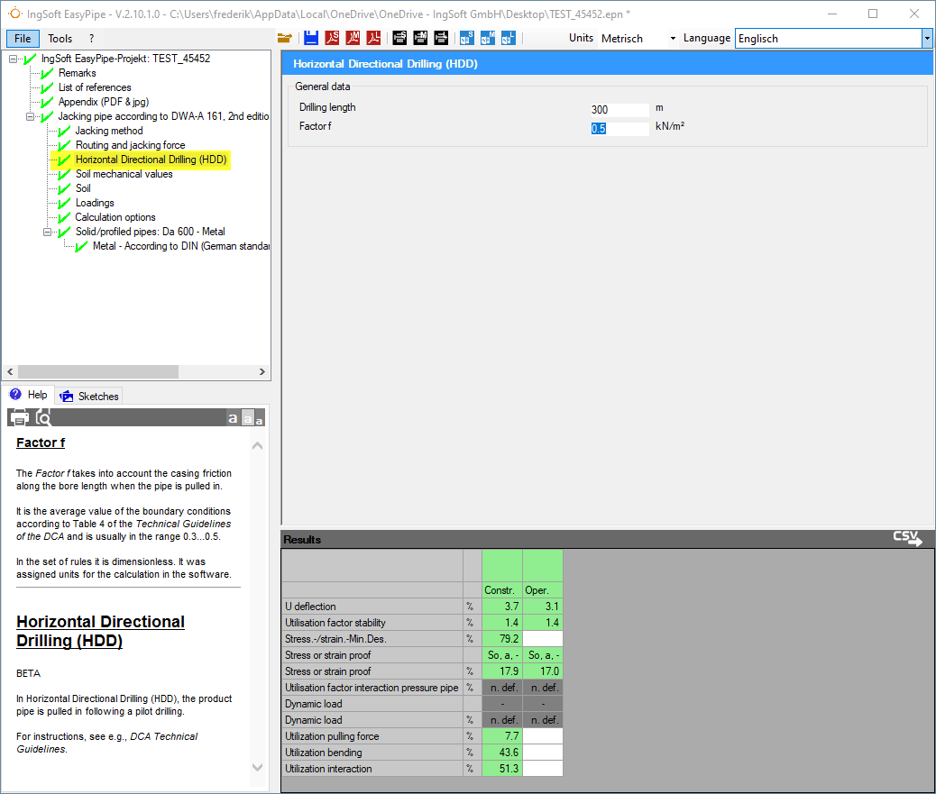
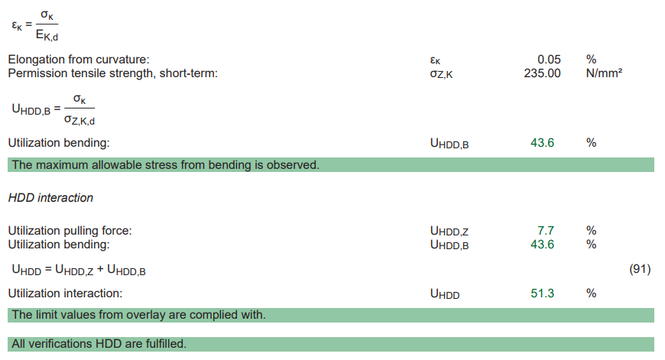
Consistent software solution
Advertisement

Slide 40
Frederik Müller
IngSoft
Department Manager Structural Analysis, Authorized Signatory
Graduate Engineer (FH) Civil Engineering, Master of Software-Engineering (M.Eng.)
Employed by IngSoft since 2010
Main focus: Sales, Support ATV-DVWK-A 127, DWA-A 161

Slide 41
Thank you for your attention
Contact
IngSoft GmbH Irrerstraße 17 90403 Nürnberg Germany
Tel: +49 911 430879-300
E-Mail: statik@ingsoft.de
Internet: www.easypipe.ingsoft.com

